Slide 1



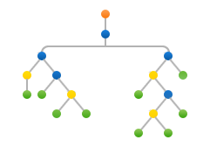
Machine Learning
Decision Tree
(Python Implementation)

Slide 2
Decision Tree (Implementation)
Perform Training :
# Function to perform training with giniIndex.
def train_using_gini(X_train, X_test, y_train):
# Creating the classifier object
clf_gini = DecisionTreeClassifier(criterion = "gini",
random_state = 100,max_depth=3, min_samples_leaf=5)
# Performing training
clf_gini.fit(X_train, y_train)
return clf_gini
# Function to perform training with entropy.
def tarin_using_entropy(X_train, X_test, y_train):
# Decision tree with entropy
clf_entropy = DecisionTreeClassifier(
criterion = "entropy", random_state = 100,
max_depth = 3, min_samples_leaf = 5)
# Performing training
clf_entropy.fit(X_train, y_train)
return clf_entropy

Slide 3
Decision Tree (Implementation)
Make Predictions and calculate accuracy :
# Function to make predictions
def prediction(X_test, clf_object):
# Predicton on test with giniIndex
y_pred = clf_object.predict(X_test)
print("Predicted values:")
print(y_pred)
return y_pred
# Function to calculate accuracy
def cal_accuracy(y_test, y_pred):
print("Confusion Matrix: ",
confusion_matrix(y_test, y_pred))
print ("Accuracy : ",
accuracy_score(y_test,y_pred)*100)
print("Report : ",
classification_report(y_test, y_pred))

Slide 4
Decision Tree (Implementation)
Driver Code :
# Driver code
def main()
# Building Phase
data = importdata()
X, Y, X_train, X_test, y_train, y_test = splitdataset(data)
clf_gini = train_using_gini(X_train, X_test, y_train)
clf_entropy = tarin_using_entropy(X_train, X_test, y_train)
# Operational Phase
print("Results Using Gini Index:")
# Prediction using gini
y_pred_gini = prediction(X_test, clf_gini)
cal_accuracy(y_test, y_pred_gini)
print("Results Using Entropy:")
# Prediction using entropy
y_pred_entropy = prediction(X_test, clf_entropy)
cal_accuracy(y_test, y_pred_entropy)

Slide 5
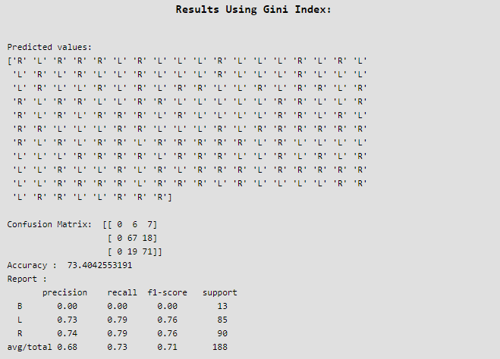
Decision Tree (Implementation)
Output (Using Gini Index):

Slide 6
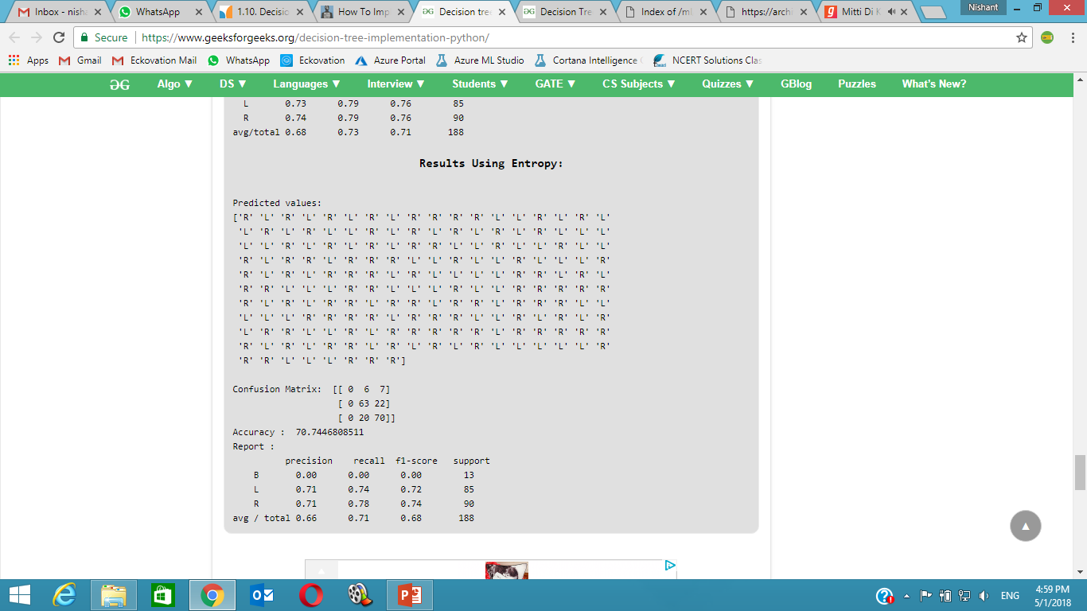
Decision Tree (Implementation)
Output (Using Entropy):

Slide 7
# Importing the required packages
import numpy as np
import pandas as pd
from sklearn.metrics import confusion_matrix
from sklearn.cross_validation import train_test_split
from sklearn.tree import DecisionTreeClassifier
from sklearn.metrics import accuracy_score
from sklearn.metrics import classification_report
# Function importing Dataset
def importdata():
balance_data = pd.read_csv(
'https://archive.ics.uci.edu/ml/machine-learning-'+
'databases/balance-scale/balance-scale.data',
sep= ',', header = None)
# Printing the dataswet shape
print ("Dataset Lenght: ", len(balance_data))
print ("Dataset Shape: ", balance_data.shape)
# Printing the dataset obseravtions
print ("Dataset: ",balance_data.head())
return balance_data
# Function to perform training with entropy.
def tarin_using_entropy(X_train, X_test, y_train):
# Decision tree with entropy
clf_entropy = DecisionTreeClassifier(
criterion = "entropy", random_state = 100,
max_depth = 3, min_samples_leaf = 5)
# Performing training
clf_entropy.fit(X_train, y_train)
return clf_entropy
# Function to make predictions
def prediction(X_test, clf_object):
# Predicton on test with giniIndex
y_pred = clf_object.predict(X_test)
print("Predicted values:")
print(y_pred)
return y_pred
# Function to calculate accuracy
def cal_accuracy(y_test, y_pred):
print("Confusion Matrix: ",
confusion_matrix(y_test, y_pred)
print ("Accuracy : ",
accuracy_score(y_test,y_pred)*100)
print("Report : ",
classification_report(y_test, y_pred))
# Function to split the dataset
def splitdataset(balance_data):
# Seperating the target variable
X = balance_data.values[:, 1:5]
Y = balance_data.values[:, 0]
# Spliting the dataset into train and test
X_train, X_test, y_train, y_test = train_test_split(
X, Y, test_size = 0.3, random_state = 100)
return X, Y, X_train, X_test, y_train, y_test
# Function to perform training with giniIndex.
def train_using_gini(X_train, X_test, y_train):
# Creating the classifier object
clf_gini = DecisionTreeClassifier(criterion = "gini",
random_state = 100,max_depth=3, min_samples_leaf=5)
# Performing training
clf_gini.fit(X_train, y_train)
return clf_gini
Decision Tree (Full Code)

Slide 8
# Driver code
def main():
# Building Phase
data = importdata()
X, Y, X_train, X_test, y_train, y_test = splitdataset(data)
clf_gini = train_using_gini(X_train, X_test, y_train)
clf_entropy = tarin_using_entropy(X_train, X_test, y_train)
# Operational Phase
print("Results Using Gini Index:")
# Prediction using gini
y_pred_gini = prediction(X_test, clf_gini)
cal_accuracy(y_test, y_pred_gini)
print("Results Using Entropy:")
# Prediction using entropy
y_pred_entropy = prediction(X_test, clf_entropy)
cal_accuracy(y_test, y_pred_entropy)
# Calling main function
if __name__=="__main__":
main()
Decision Tree (Full Code)

